Slide 1
Chapter 4.1 Inequalities and their Graphs
Algebra Concepts

Slide 2
Objective
Students will be able to graph inequalities on a number line.

Slide 3
Inequalities
Math sentences containing
  < , > , ≤ , ≥
  < “is less than”
  > “is greater than”
  ≤ “is less than or equal to”
  ≥ “is greater than or equal to”

Slide 4
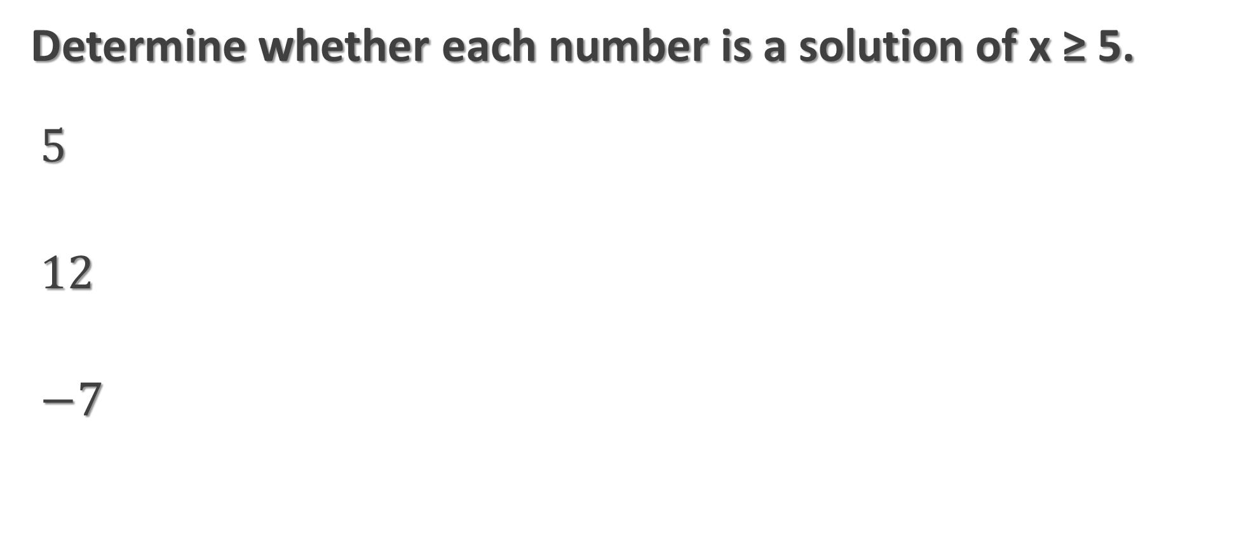
EX.) 1
Determine whether each number is a solution of x ≥ 5.
$$5$$
$$12$$
$$−7$$

Slide 5
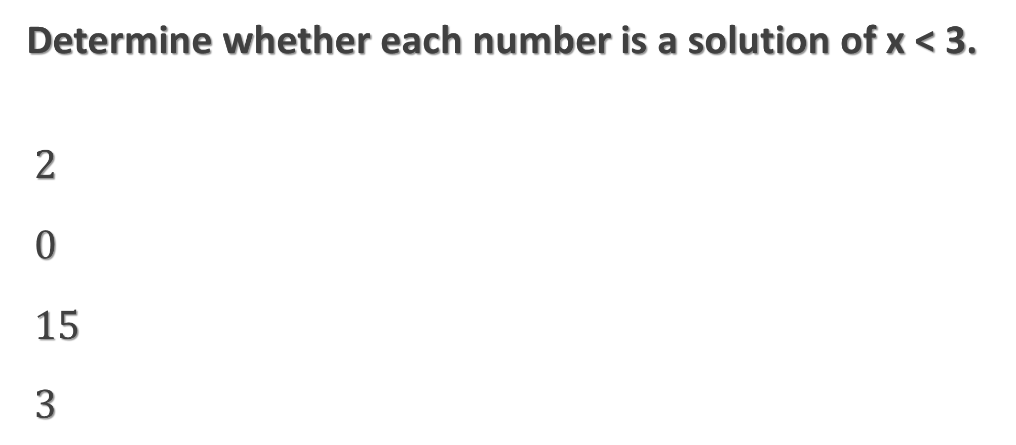
EX.) 2
Determine whether each number is a solution of x < 3.
$$2$$
$$0$$
$$15$$
$$3$$

Slide 6
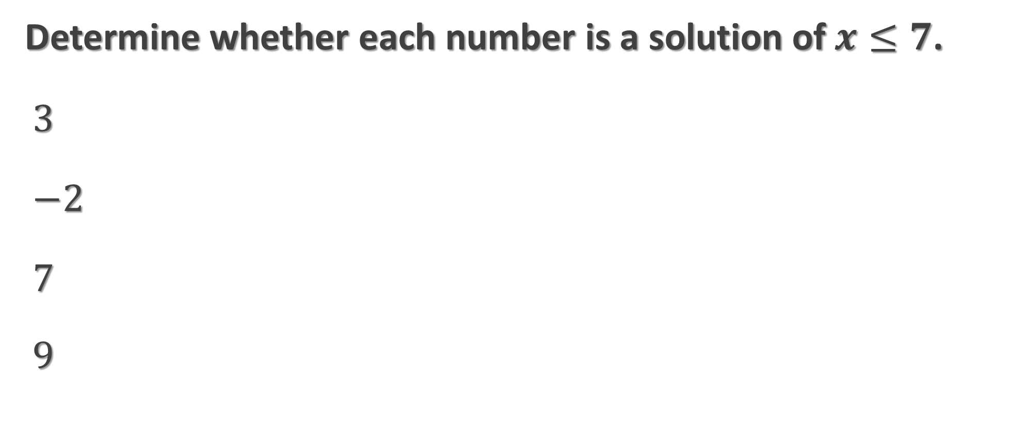
EX.) 3
Determine whether each number is a solution of$x≤7$.
$$3$$
$$−2$$
$$7$$
$$9$$

Slide 7
Graphing Inequalities
Circle the number
≤ , ≥ , = use filled in circle
< , > use empty circle
Shade in number line for solutions
Arrows point to which way to shade

Slide 8
EX.4)
Graph x < 2 on a number line.

Slide 9
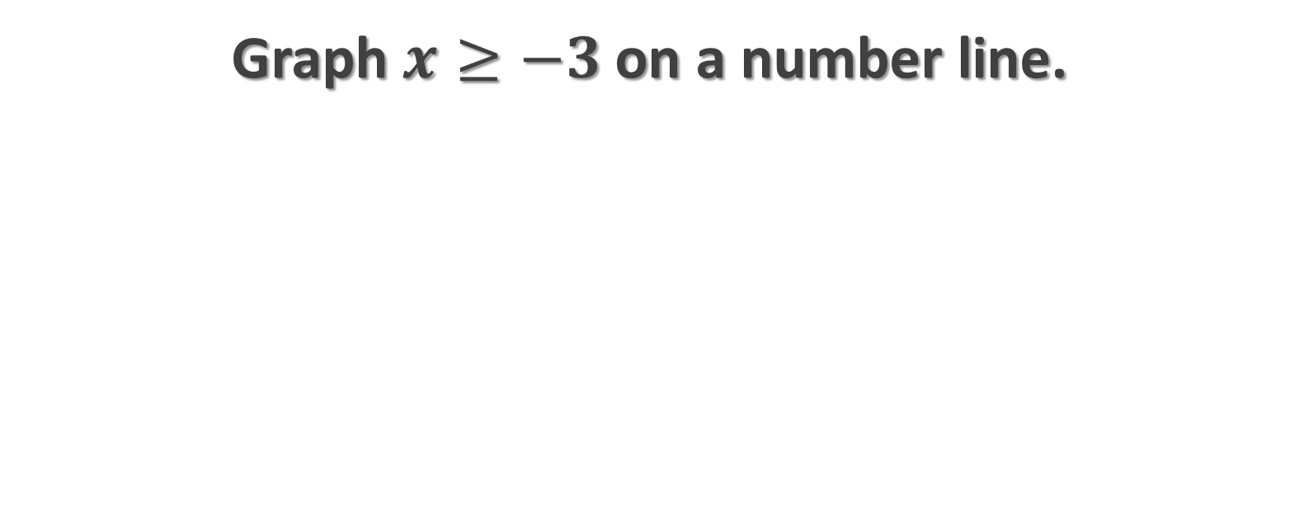
EX.5)
Graph $x≥−3$on a number line.

Slide 10
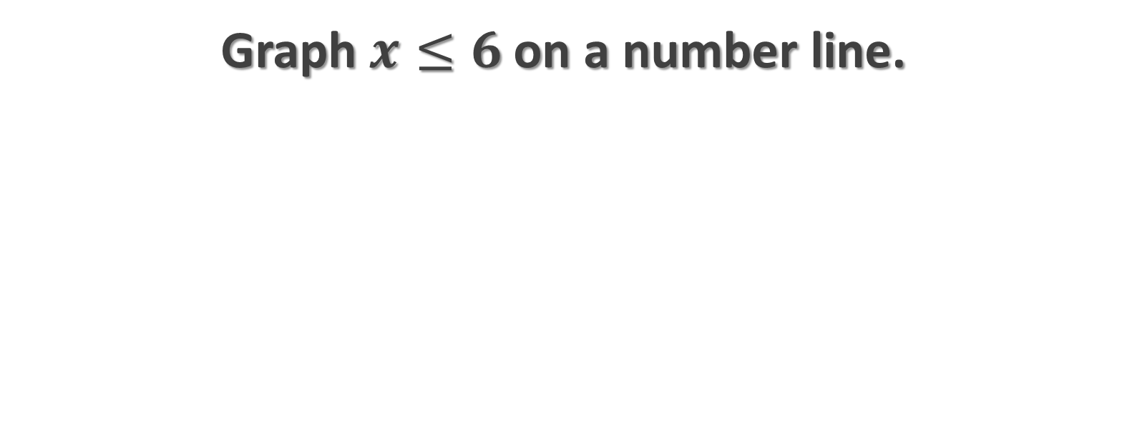
EX.6)
Graph $x≤6$on a number line.

Slide 11
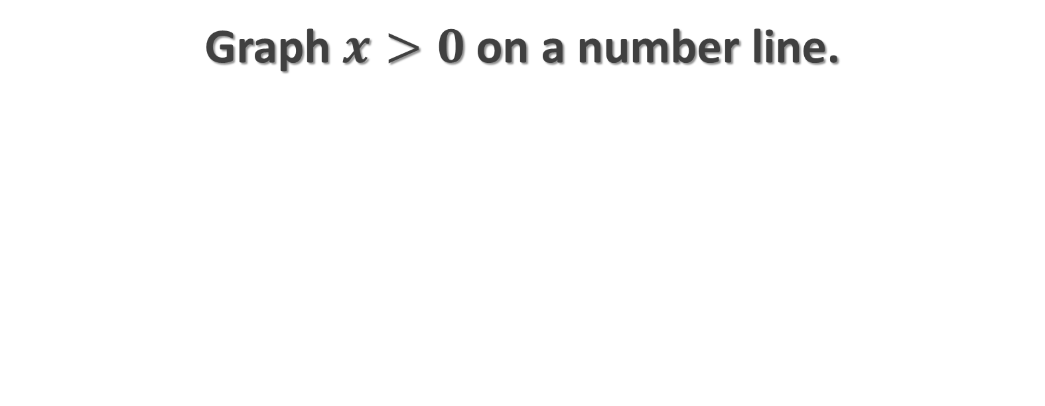
EX.7)
Graph $x>0$on a number line.

